Slide 1



Isack Odero
ML Eng LogAI

Slide 2
How Computer See and Talk
Computer Vision
Sequence Modeling

Slide 3

Computer Vision

Slide 4
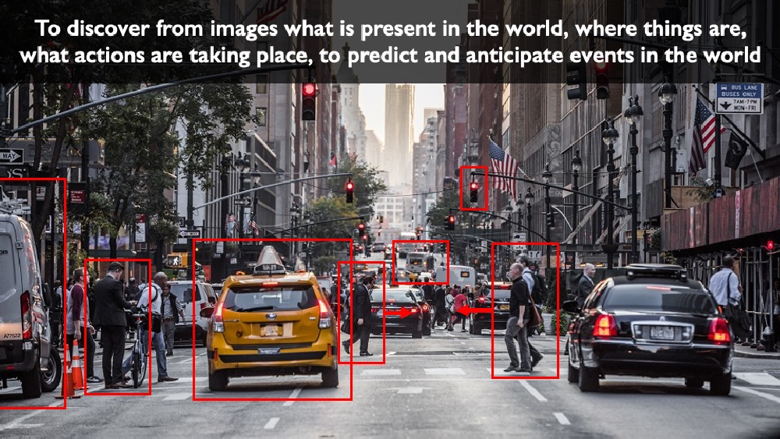
Computer Vision

Slide 5
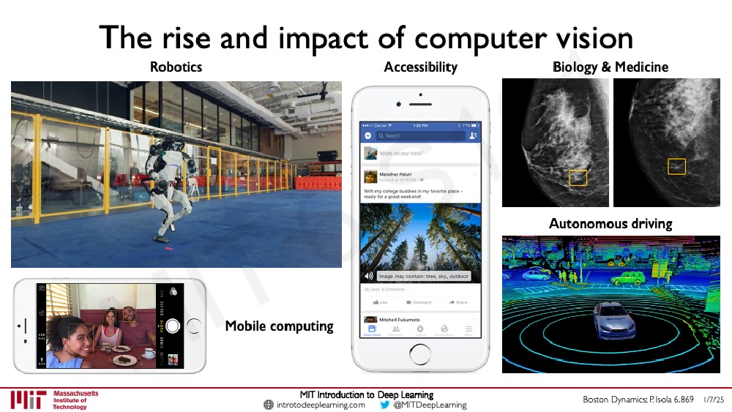
Computer Vision

Slide 6
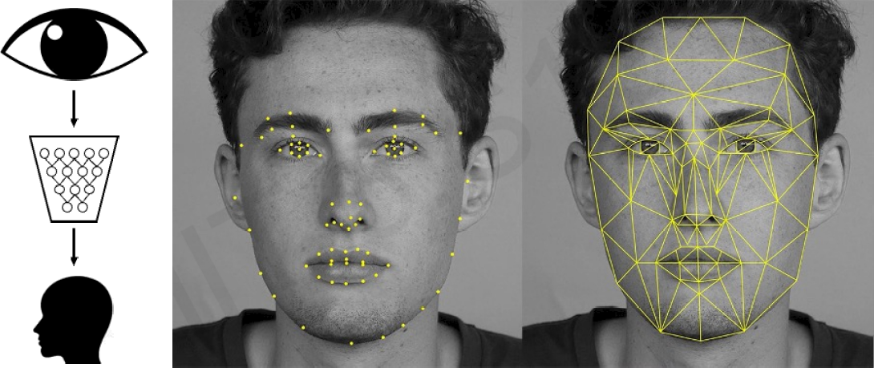
Impact: Facial Recognition

Slide 7
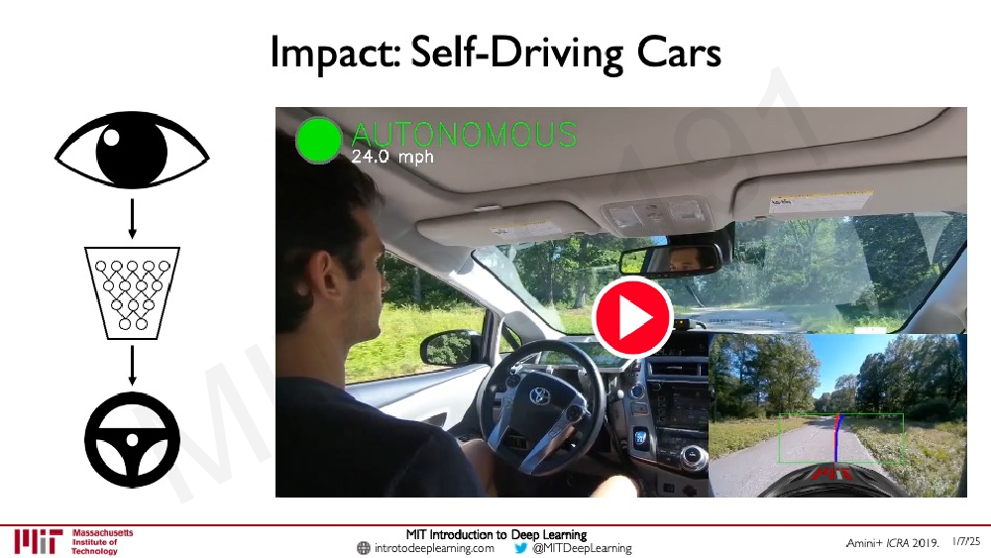
Impact: Autonomous Driving

Slide 8
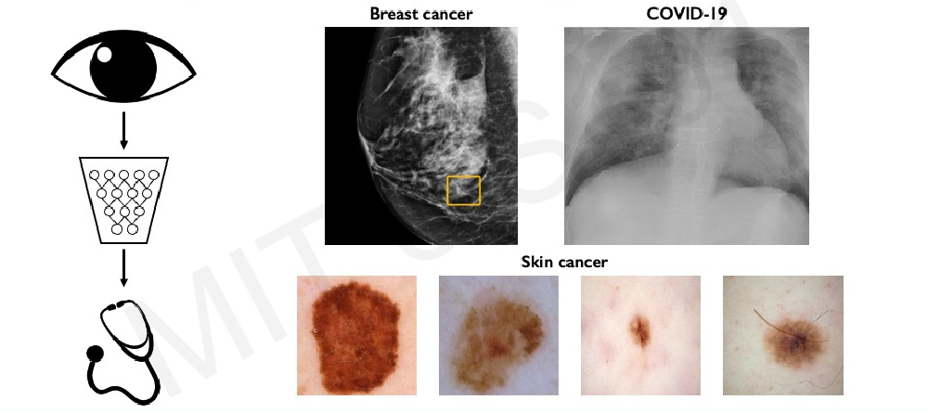
Impact: Medicine, Biology, Healthcare

Slide 9
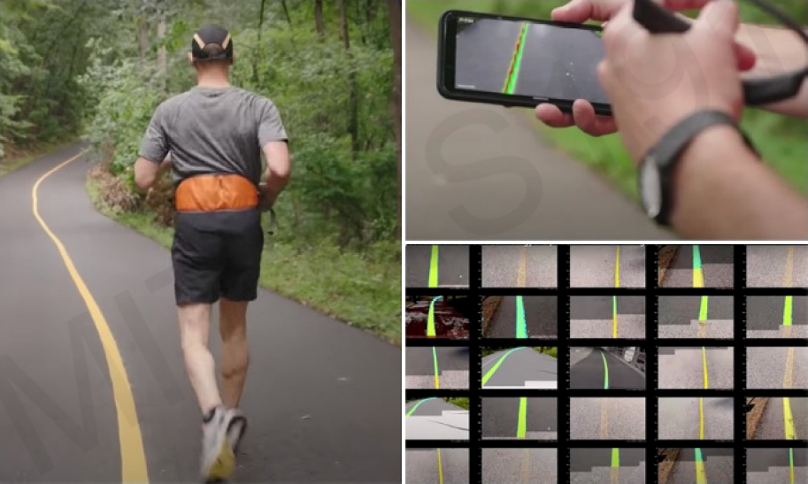
Impact: Medicine, Biology, Healthcare

Slide 10
What Computers “See”

Slide 11
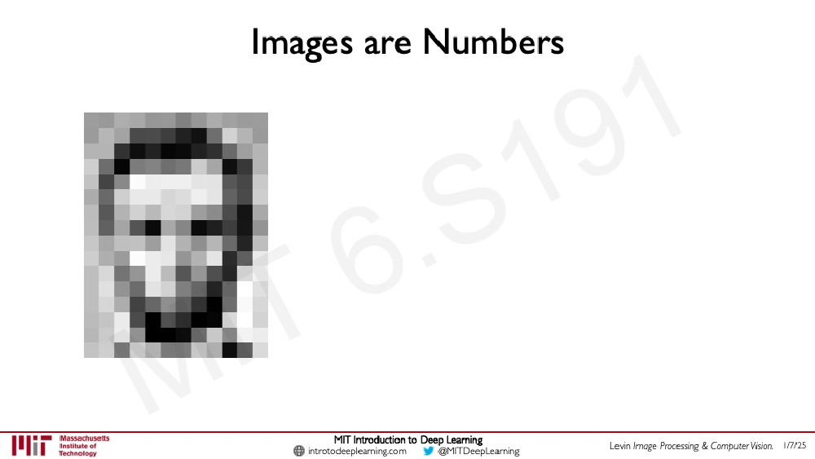
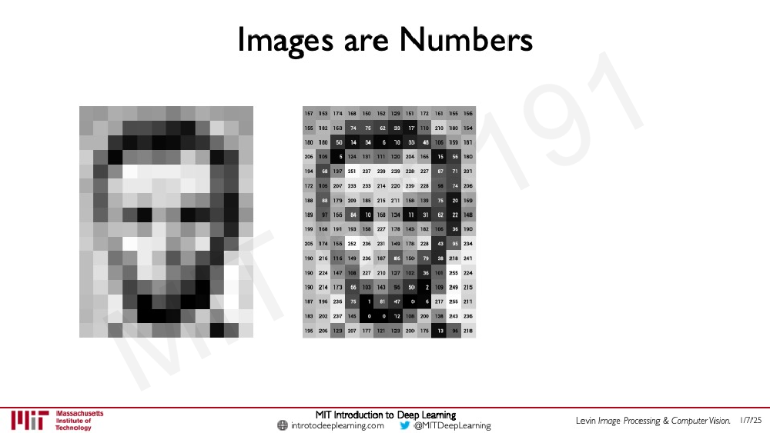
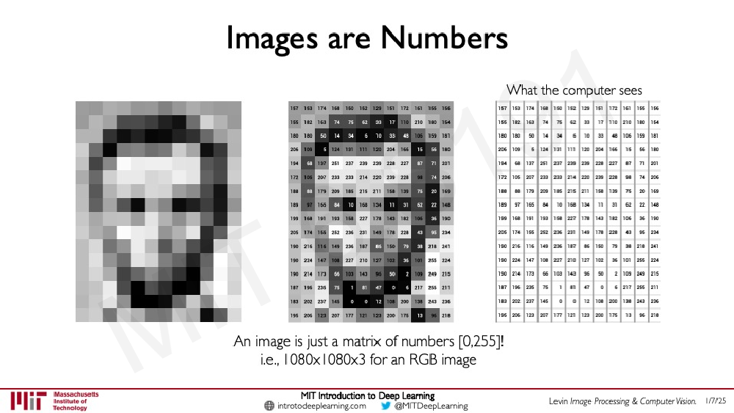
Images are Numbers
An image is just a matrix of numbers [0, 255]
I.e. 1080x1080x3 an RGB image

Slide 12
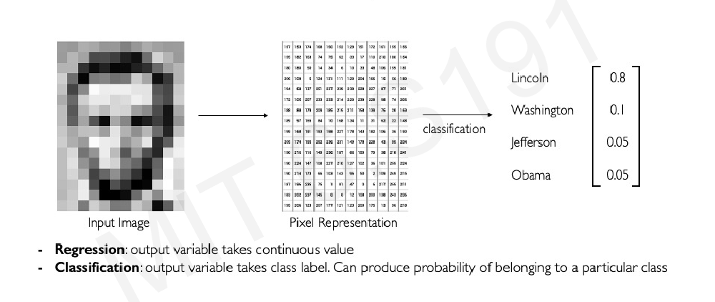
Tasks in Computer Vision

Slide 13
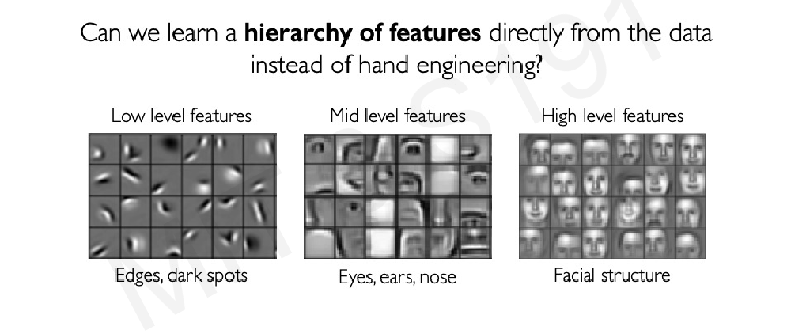
Learning Feature Representations

Slide 14
An Architecture for Many Applications

Slide 15
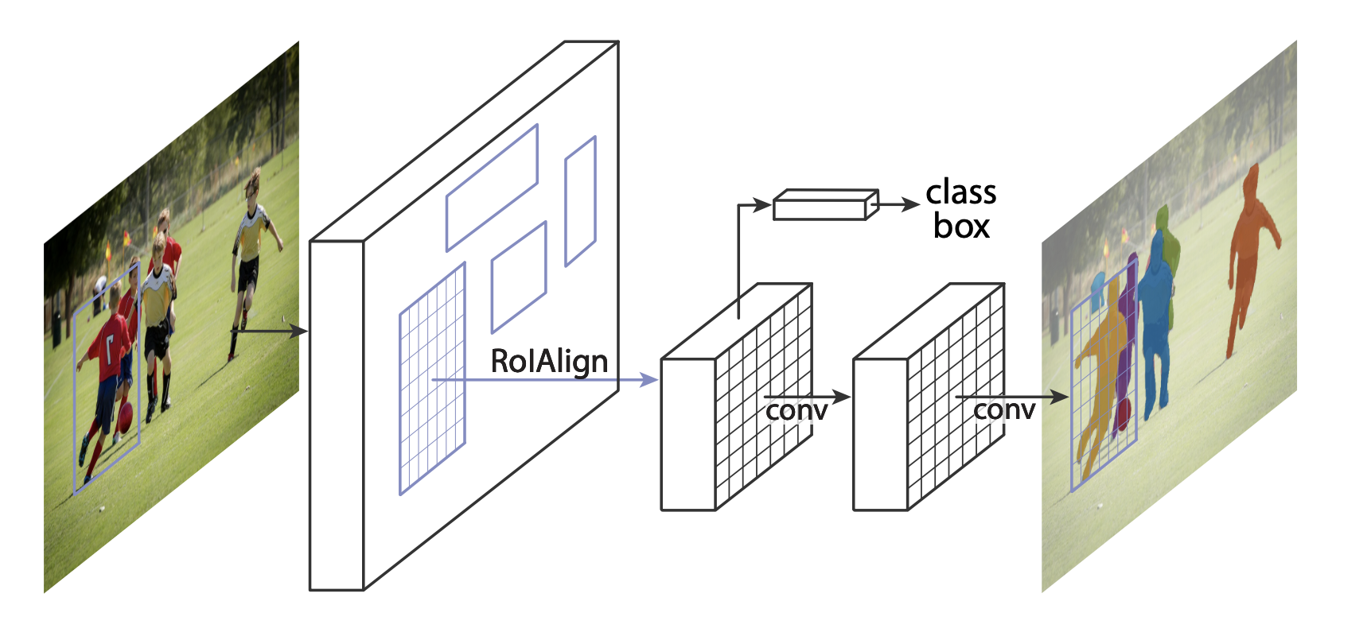

Slide 16


Slide 17
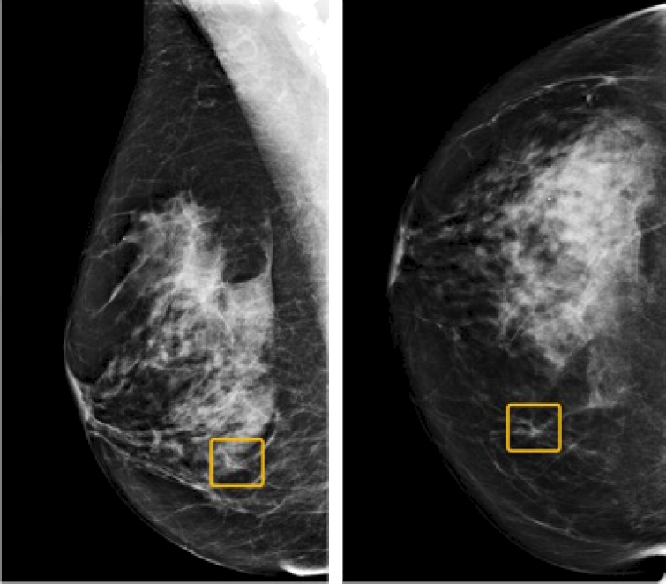
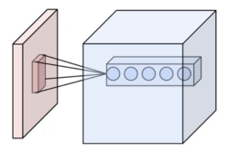

Classification: Breast Cancer Screen

Slide 18
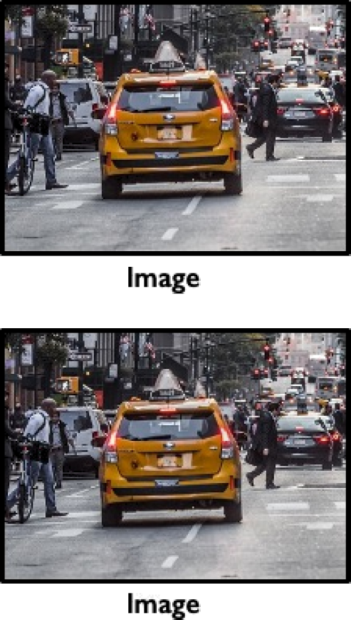

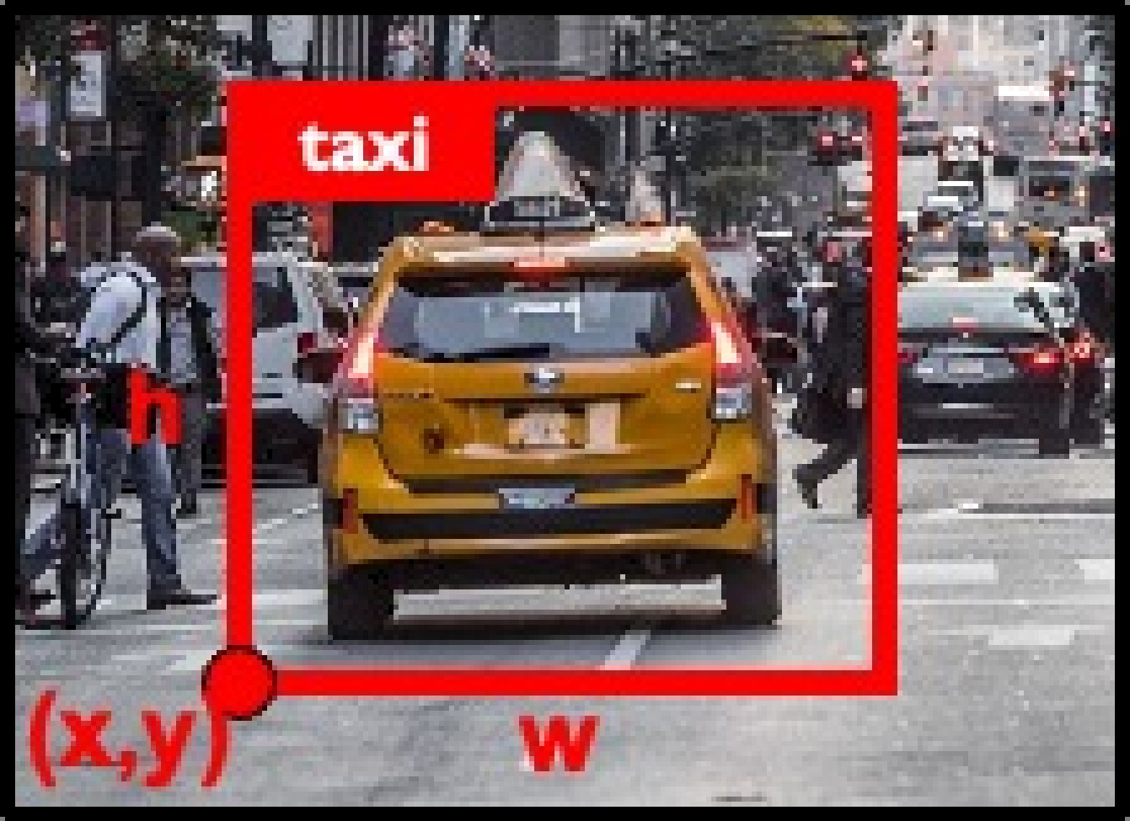
Object Detection

Slide 19
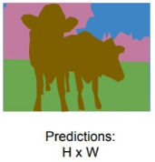
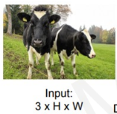
Semantic Segmentation

Slide 20
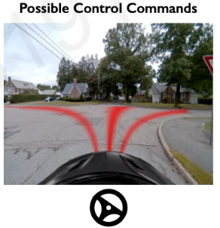
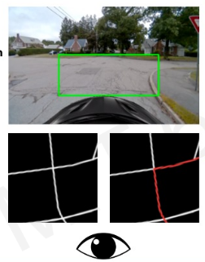
Continuous Control Navigation

Slide 21
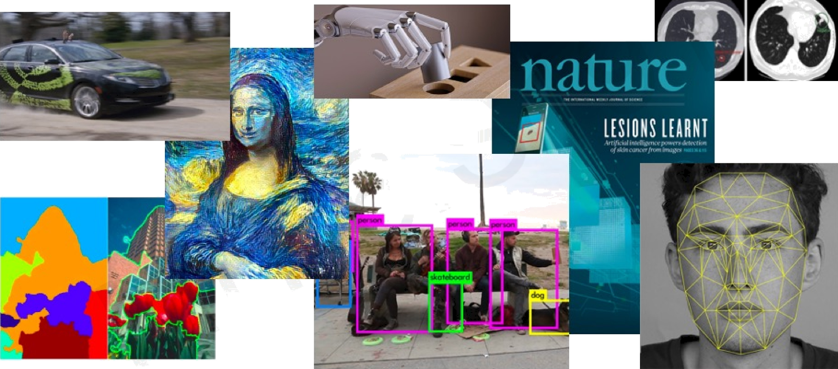
Deep Learning for Computer Vision

Slide 22
Sequence Modeling

Slide 23
Given an Image of a ball, can you predict where it will go next?

Slide 24


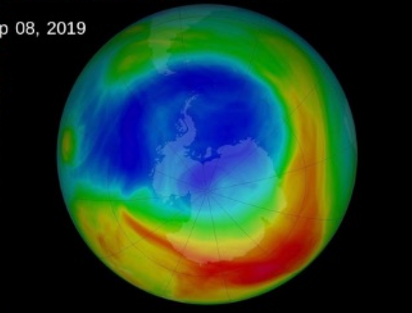



Sequence data

Slide 25



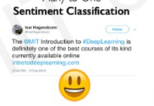

Sequence Modeling Application

Slide 26
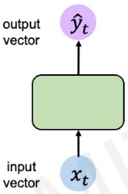
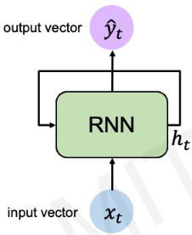
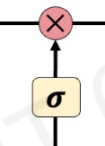
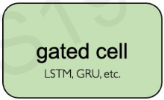

Sequence Modeling Type
1. Sequence Modeling with Recurrence
Models: RNN, LSTM, GRU Core Idea: Process sequences step-by-step, maintaining a hidden state that captures past information.

Slide 27
Sequence Modeling Type
1. Sequence Modeling with Recurrence
Models: RNN, LSTM, GRU Core Idea: Process sequences step-by-step, maintaining a hidden state that captures past information.
Pros Cons
✔ Handles variable-length sequences well
✖ Struggles with long-range dependencies
✔ Low memory usage (sequential processing)
✖ Slow training (no parallelization)
✖ Prone to vanishing/exploding gradients (RNNs)
✔ Simple architecture

Slide 28

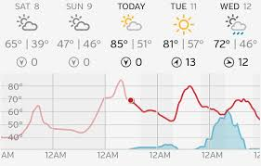

Sequence Modeling Type
1. Sequence Modeling with Recurrence
Models: RNN, LSTM, GRU Core Idea: Process sequences step-by-step, maintaining a hidden state that captures past information.
Applications
Early NLP (machine translation, sentiment analysis)
Time-series forecasting (stock prices, weather)

Slide 29
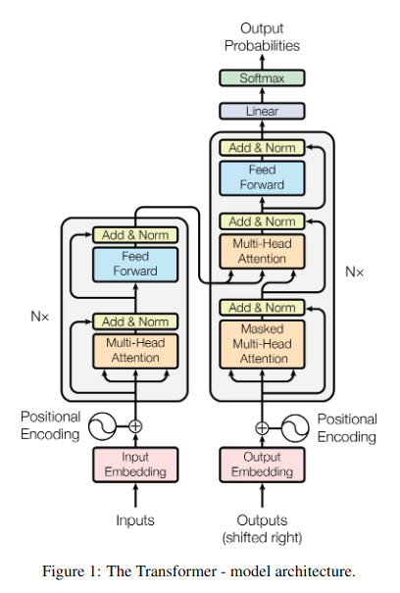
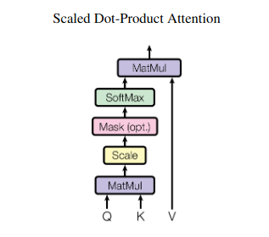
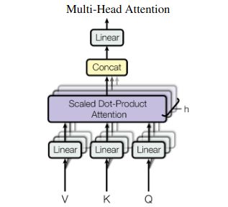
Sequence Modeling Type
2. Sequence Modeling with Attention
Models: Transformers (BERT, GPT) Core Idea: Weigh the importance of all past inputs dynamically using self-attention.

Slide 30
Sequence Modeling Type
2. Sequence Modeling with Attention
Models: Transformers (BERT, GPT) Core Idea: Weigh the importance of all past inputs dynamically using self-attention.
Pros Cons
✔ Captures long-range dependencies better
✖ High memory usage (stores all tokens)
✔ Parallel processing (faster training)
✖ Computationally expensive
✖ Requires large datasets
✔ State-of-the-art performance (e.g., GPT-4)

Slide 31









Sequence Modeling Type
2. Sequence Modeling with Attention
Models: Transformers (BERT, GPT) Core Idea: Weigh the importance of all past inputs dynamically using self-attention.
Applications
Modern NLP (ChatGPT, translation, summarization)
Vision tasks (ViT - Vision Transformers)

